Slide 1
ASSESSMENT OF ACCUTE STROKE ISCHEMIA
RAZIAH BEGUM
CLINICAL INSTRUCTOR
DEPARTMENT OF NURSING
UNIVERSITI SELANGOR

Slide 2
Disability, Disparity, Death, & Dollars
Stroke is the 4th leading cause of death in the US and the #1 cause of permanent disability
Each year, 795,000 people experience a new or recurrent stroke
Every 4 minutes someone dies of stroke
Americans pay about $74 billion/year in stroke-related medical & disability costs

Slide 3
DEFINITION
A stroke is
a "brain attack".
It occurs when blood flow to an area of brain is cut off.
When this happens, brain cells are deprived of oxygen and begin to die.
When brain cells die during a stroke, abilities controlled by that area of the brain such as memory and muscle control are lost

Slide 4
Three Stroke Types

Slide 5
Ischemic stroke
when a blood vessel carrying blood to the brain is blocked by a blood clot.
causes blood not to reach the brain. High blood pressure is the most important risk factor for this type of stroke.
Ischemic strokes account for about 87% of all strokes.

Slide 6
Etiology of Ischemic Strokes
LARGE VESSEL EMBOLIC:
The Heart
Valve diseases, A. Fib, Dilated cardiomyopathy, Myxoma
Arterial Circulation (artery to artery emboli)
Atherosclerosis of carotid, Arterial dissection, Vasculitis
The Venous Circulation
PFO w/R to L shunt, Emboli

Slide 8
Investigation
CT scan. Demonstrates structural abnormalities, edema, hematomas, ischemia, and infarctions. Demonstrates structural abnormalities, edema, hematomas, ischemia, and infarctions. Note: May not immediately reveal all changes, e.g., ischemic infarcts are not evident on CT for 8–12 hr; however, intracerebral hemorrhage is immediately apparent; therefore, emergency CT is always done before administering tissue plasminogen activator (t-PA). In addition, patients with TIA commonly have a normal CT scan
PET scan. Provides data on cerebral metabolism and blood flow changes.
MRI. Shows areas of infarction, hemorrhage, AV malformations, and areas of ischemia.

Slide 9
Cerebral angiography. Helps determine specific cause of stroke, e.g., hemorrhage or obstructed artery, pinpoints site of occlusion or rupture. Digital subtraction angiography evaluates patency of cerebral vessels, identifies their position in head and neck, and detects/evaluates lesions and vascular abnormalities.
Lumbar puncture. Pressure is usually normal and CSF is clear in cerebral thrombosis, embolism, and TIA. Pressure elevation and grossly bloody fluid suggest subarachnoid and intracerebral hemorrhage. CSF total protein level may be elevated in cases of thrombosis because of inflammatory process. LP should be performed if septic embolism from bacterial endocarditis is suspected.
Transcranial Doppler ultrasonography. Evaluates the velocity of blood flow through major intracranial vessels; identifies AV disease, e.g., problems with carotid system (blood flow/presence of atherosclerotic plaques).

Slide 10
EEG. Identifies problems based on reduced electrical activity in specific areas of infarction; and can differentiate seizure activity from CVA damage.
Skull x-ray. May show a shift of pineal gland to the opposite side from an expanding mass; calcifications of the internal carotid may be visible in cerebral thrombosis; partial calcification of walls of an aneurysm may be noted in subarachnoid hemorrhage.
ECG and echocardiography. To rule out cardiac origin as source of embolus(20% of strokes are the result of blood or vegetative emboli associated with valvular disease, dysrhythmias, or endocarditis).
Laboratory studies to rule out systemic causes: CBC, platelet and clottingstudies, VDRL/RPR, erythrocyte sedimentation rate (ESR), chemistries (glucose, sodium).

Slide 11
The Role of Nurses in Stroke Care
Central part of the interdisciplinary team
Care coordination across the continuum
Most direct contact with patients and caregivers
Carry out interventions needed to manage treatment and monitor patients’ responses
Directly impact quality outcomes
Implement best practices
Contribute to prevention of stroke, related complications, and recurrent stroke

Slide 12
Neurological Assessment
Traditional neuro checks performed by nursing
Simple ways to fine-tune neuro assessments
NIH Stroke Scale
Standard measure of neurological function and stroke severity through systematic assessment of stroke deficits
Assists in developing individualized plan of care
Free online training modules
Better identification of neuro changes leading to prompt intervention and treatment

Slide 13
Breaking Down the Scale
13 item scoring system, 7 minute exam
Integrates neurologic exam components
CN (visual), motor, sensory, cerebellar, inattention, language, LOC
Maximum score is 42, signifying severe stroke
Minimum score is 0, a normal exam
Scores greater than 15-20 are more severe

Slide 14
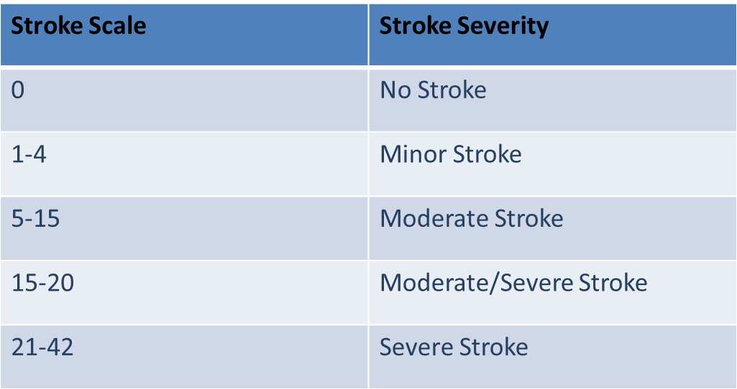
NIHSS Interpretation

Slide 15
NIHSS and outcome prediction
NIHSS below 12-14 will have an 80% good or excellent outcome
NIHSS above 20-26 will have less than a 20% good or excellent outcome
Lacunar infarct patients had the best outcomes

Slide 16
Cardiovascular Guidelines
Cardiac monitoring
Blood pressure management
Hypovolemia
Supplemental oxygen
Hyperthermia

Slide 17
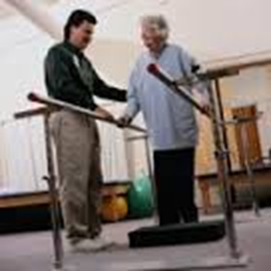
Motor Function
Better outcomes associated with specialized stroke units
Early focus on rehabilitation
Collaboration with PT and OT
ADL training
Nursing assistive personnel
Staff education provided by PT and OT members of the interdisciplinary team

Slide 18
DVT Prevention
Higher risk in stroke
Associated with increased
mortality and morbidity
Preventable!
Major performance
measure for CMS
Early mobilization
Enoxaparin 40 mg daily
Sequential compression devices
Compression stockings

Slide 19
Fall Prevention
Greater risk of falling in stroke patients
Multi-factorial risks
Assess for risk of falling using an evidence-based falls risk assessment tool
Implement falls precautions
Interventions should
match risk factors
Use all available tools!

Slide 20
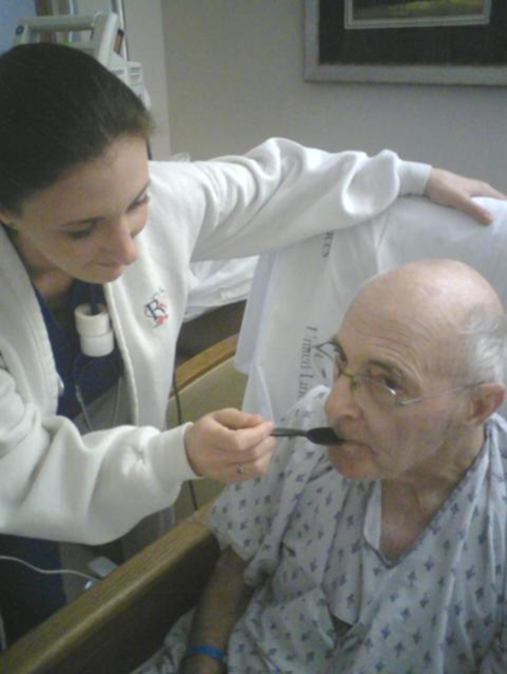
Dysphagia
Up to half are dysphagic
Risk of aspiration pneumonia is increased x 7
Assess swallow before the patient begins eating, drinking or taking oral medications
Nursing Bedside Swallow Screening
Nursing interventions

Slide 21
Malnutrition
Contributing factors
Reported in 50% at 2-3 weeks after stroke
Enteral feedings
NG feedings
Monitoring
Daily weights (loss of >3 kg)
Intake and output
Blood counts
Nutritional supplements

Slide 22
Bowel/Bladder Management
Central aspect of stroke care
Nursing assumes major responsibility of assessment and management
Monitor I&O and recognize potential problems
Risk for constipation
Indwelling urinary catheters not recommended
Urinary retention
Incontinence
Patient and family education

Slide 23
Promoting Skin Integrity
Risk for skin breakdown
Skin assessment at least every 8 hours
Use of an evidence-based assessment tool
Turn and reposition at least every 2 hours
Keep patients clean and dry
Utilize products and tools for pressure reduction
Nurse-driven protocols

Slide 24
Seizures
Hemorrhagic stroke – 11%; Ischemic – 9%
Monitor for seizure activity and implement seizure precautions
Understand seizure classifications
Nurses are first responders
Remain with the patient
Apply O2; turn patient to side
Observe times, behaviors, autonomic signs
Notify physician and carry out orders

Slide 25
Sleep Apnea
Relationship between sleep apnea and stroke
Increased risk in the elderly (70-100 years old)
Role of nursing in identifying sleep apnea
Diagnosis
Treatment
Lifestyle changes
Mouthpieces
CPAP
Surgery

Slide 26
Depression Screening
Associated with poorer quality of life and increased mortality
Present in nearly 20% of stroke survivors
Nurses may be first to notice symptoms
Depression screening
Risk for depression in family caregivers

Slide 27
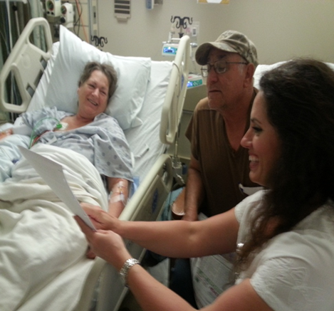
Stroke Education
Patient and family caregiver education
Staff education
Community education

Slide 28
Patient and Family Education
Prevention begins with education!
Effective stroke education is a hallmark of better stroke care and is considered a critical part of the chain of survival
Both ischemic and hemorrhagic stroke patients and their caregivers
Individualize education on stroke, including the risk factors and warning signs
Make it relevant to them – “tell them WHY and they may COMPLY”
Initiated early in the patient’s stay
Repetition increases retention of learned information
The TEAM approach is the best approach

Slide 29
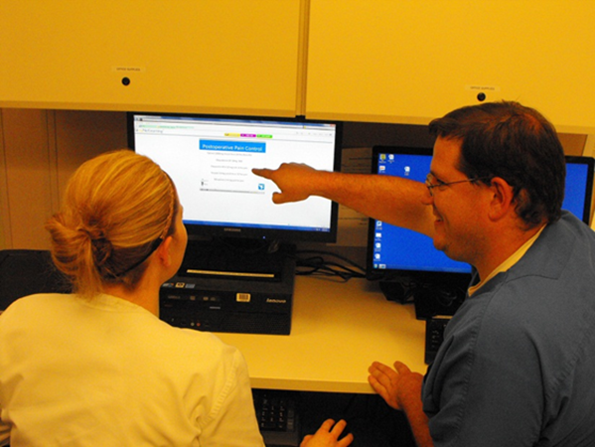
Staff Education
Develop, validate and maintain competency
Assemble a multidisciplinary team
Define goals
Establish program-specific requirements
Identify and respond to specific learning needs
Develop an Education Plan
Orientation and training
Continuing education
Use your resources
Be creative!

Slide 30
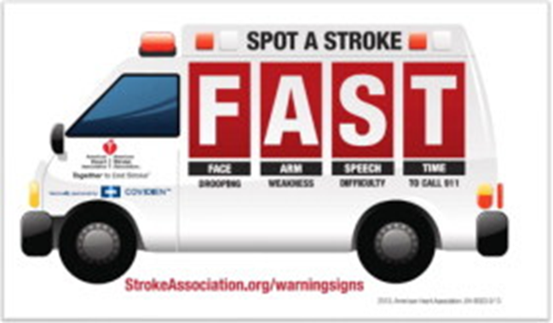
Community Education
Basic info – risk factors, warning signs, call 911!
Health fair booths
Schools
Senior centers/residential facilities
Businesses/companies
EMS personnel – vital role in stroke care
collaboration between EMS & stroke centers
Lunch & learn sessions
Review calls/case studies –
recognize/give feedback
Sponsor BLS courses
Invite them! Involve them!

Slide 31
Patient Advocacy
Nurses can be a powerful force in decreasing the burden of stroke
Effectively educating patients and families about the risk factors and warning signs of stroke
Participating in community teaching settings
Empowering patients by providing them with resources ( Stroke Survivors Support Groups)
Encouraging them to be involved in their care
Becoming involved with federal issues and campaigns that support research, prevention and access to quality care and rehabilitation

Slide 32
Conclusion
Nurses are at the forefront of stroke care
Implications for reducing morbidity and mortality
Comprehensive patient assessments
Delivery of quality patient care
Commitment to education and prevention
Advocate to improve overall stroke care

Slide 33
References
Cappelle, L.J. (2011). Preventing deep vein thrombosis after stroke: Strategies and recommendations. Current Treatment Options in Neurology; 13(6): 629–635.
Daniels, C. S., Johnson, J. R., & Mackovjak, J. (2011). Presenting a successful stroke education model to meet the Joint Commission’s Disease-specific care certification. Journal for Nurses in Staff Development, 27 (2), 74-80.
Go, A.S. et. al. (2014). Heart Disease and Stroke Statistics – 2014 Update: A Report from the American Heart Association. Circluation; 129: 28-288. Available at: http://circ.ahajournals.org/
Jauch, E.C., Saver, J.L., Adams, H.P., Bruno, A., Connors, J.J., Demaerschalk, B.M…Yonas, H. (2013). Guidelines for the early management of patients with acute ischemic stroke: A guideline for healthcare professionals from the American Heart Association/American Stroke Association. Stroke, 44: 870-947.
Joint Commission on Accreditation of Healthcare Organizations. (2014). Prepublication requirements for Primary Stroke Center Advanced Certification. Retrieved from: http://www.jointcommission.org/assets/1/6/PSC_DSC_March2014.pdf
Miller, E.L., Murray, L., Richards, L., Zorowitz, R.D., Bakas, T., Clark, P., & Billinger, S.A. (2010). Comprehensive overview of nursing and interdisciplinary rehabilitation care of the stroke patient: A scientific statement from the American Heart Association. Stroke, 41: 2402-2448. Available at: http://stroke.ahajournals.org
Ovbiagele, B., Goldstein,L.B., Higashida,R.T., Howard V.J., Johnston, S.C., Khavjou, O.A., Lackland, D.T., Lichtman, J.H., Mohl, S., Sacco, R.L., Saver, J.L. & Trogdon, J.G., on behalf of the American Heart Association Advocacy Coordinating Committee and Stroke Council AHA/ASA. (2013). Policy Statement Forecasting the Future of Stroke in the United States: A Policy Statement From the American Heart Association and American Stroke Association. Stroke. 2013;44:2361-2375.

Slide 34
Q&A
THANK YOU FOR LISTENING AND FOCUS

