Slide 1
palliative and end of life care for neuro emergency patient
Prapaporn langputeh, rn, apn,phd
Fatoni university, Thailand
Husada nursing college, central Jakarta, Indonesia
25th October 2018

Slide 2
outline
Neurologic emergency
Stroke
Palliative care
Competencies
Religion and spiritual in palliative care
Barriers in availing palliative care

Slide 3
Neurologic emergencies
Neurologic emergencies are such as acute stroke, status epilepticus, subarachnoid hemorrhage, neuromuscular weakness, and spinal cord injury

Slide 4
Neurologic emergencies
Tend to have high symptom burdens, variable disease courses, and poor prognoses that affect not only patients but also their families and caregivers.

Slide 8
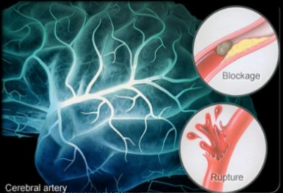
Stroke

Slide 9
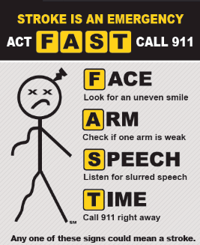

Slide 12
Stroke
Tend to have high symptom burdens, variable disease courses, and poor prognoses that affect not only patients but also their families and caregivers.

Slide 18
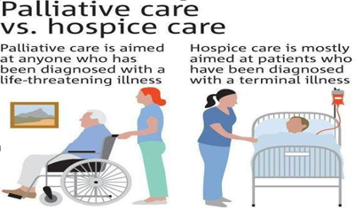

Slide 43
“Good death” in the most appropriate location.
Better pain and symptom management.
Better long term outcomes for bereaved relatives.
Improved experience of care.
Better quality of care.
Lower health care costs.
Zhang et al. Arch Intern Med Vol 169(5) Mar 9 2009:480-488
Notes:
43
From: Curriculum Package / Facilitators’ Guide – The Palliative Approach to Chronic Disease Management, BCHPCA Learning Centre for Palliative Care, July 2009.
It has been demonstrated that when a palliative approach is part of care for those with chronic illness that there are improved outcomes, for the person, family and the health care system. Such as these identified on the slide:
One recent study, by Zhang in 2009, showed that health care costs in last weeks of life are associated with End of Life conversations. It was a prospective multi institutional longitudinal evaluation of patients with advanced cancer and primary informal caregivers enrolled over 5 years who were interviewed at baseline and followed up until death. Study showed patients with advanced cancer who reported EoL conversations with physicians had significant lower HC costs in final weeks of life. Higher costs were associated with worse QOL outcomes.
Zhang, Baohui et al. (2009). Health Care Costs in the Last Week of Life. Associations with End-of-Life Conversations. In Archives of Internal Medicine. Volume 169 (No. 5).

